Slide 1



Debojyoti Majumder

Slide 2

MongoDB and it’s different Components
What is MongoDB ?
What is Mongo ?
What is MongoD ?
What is Mongo Compass ?
What is Mongo Atlas ?

Slide 3
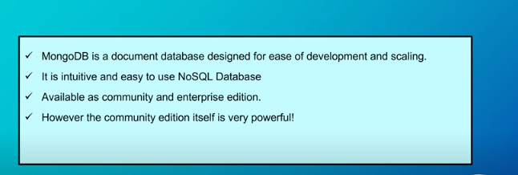
MongoDB

Slide 4
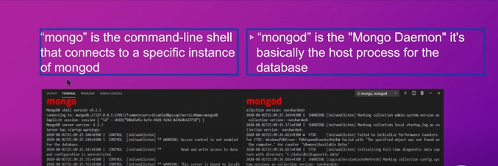
Mongo vs Mongod

Slide 5
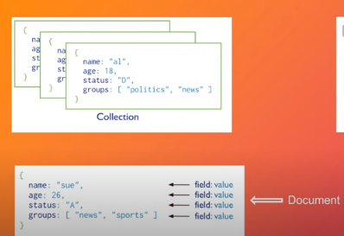
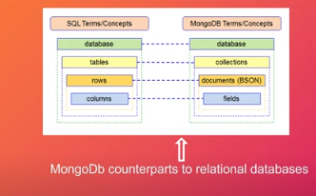
Comparison MongoDB with Conventional Database (like Sql-SERVER,MYSql…)

Slide 6
About : BSON
BSON stands for Binary Javascript Object Notation. It is a bin­ary-en­coded seri­al­iz­a­tion of JSON documents. BSON has been extended to add some optional non-JSON-native data types, like dates and binary data.
Though JSON and BSON have near identical names, they are not identical in purpose. BSON is based on JSON but has its own distinct features and advantages.

Slide 7
BSON Continue…
BSON is a binary encoded Javascript Object Notation (JSON)—a textual object notation widely used to transmit and store data across web based applications. JSON is easier to understand as it is human-readable, but compared to BSON, it supports fewer data types. BSON encodes type and length information, too, making it easier for machines to parse.
{"hello": "world"} →
\x16\x00\x00\x00 // total document size
\x02 // 0x02 = type String
hello\x00 // field name
\x06\x00\x00\x00world\x00 // field value
\x00 // 0x00 = type EOO ('end of object’)
Just like JSON, BSON supports various programming languages such as C, C++, C#, Java, JavaScript, PHP, Python, Ruby, and Swift.

Slide 8

Official Site for MongoDB https://www.mongodb.com/

Slide 9
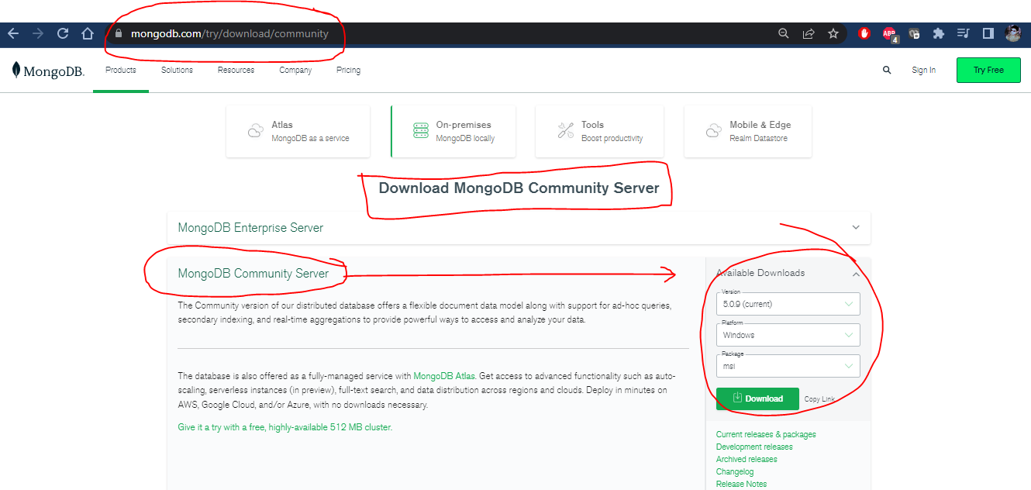
Download MongoDB Community Server

Slide 10
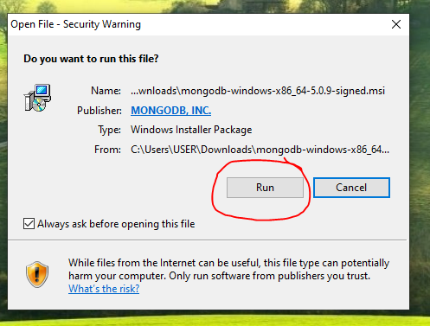
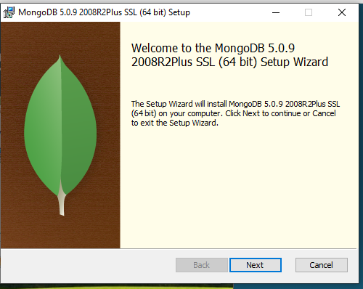
Installation Steps:

Slide 11
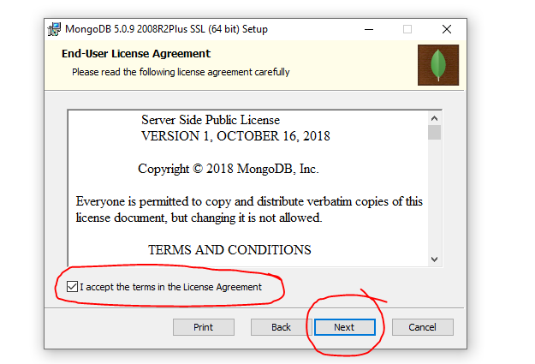
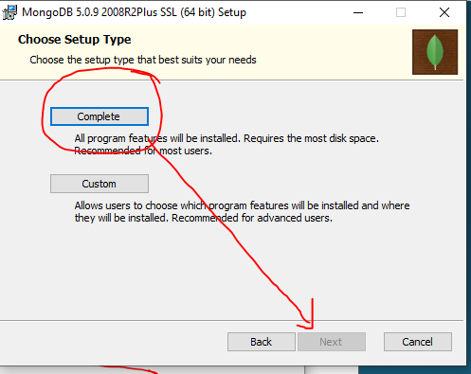
Installation Steps:

Slide 12
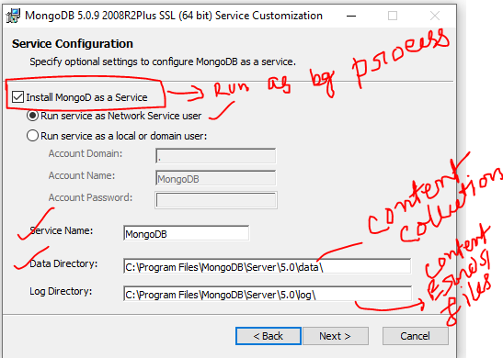
Installation Steps:

Slide 13
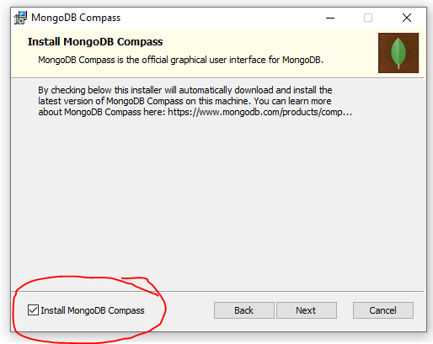
Installation Steps:

Slide 14
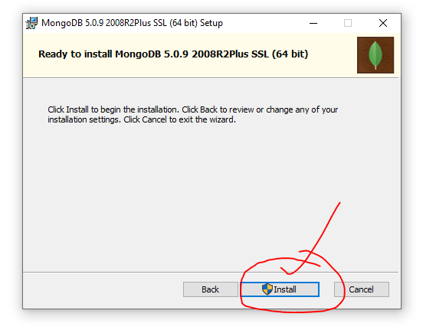
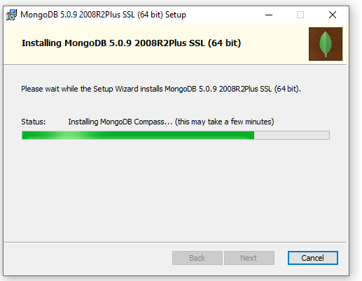
Installation Steps:

Slide 15
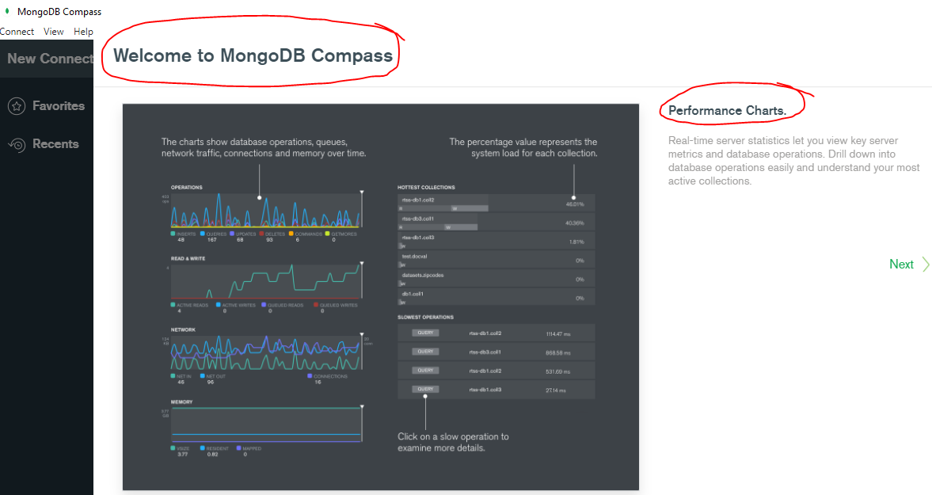
Welcome to MongoDB Compass

Slide 16
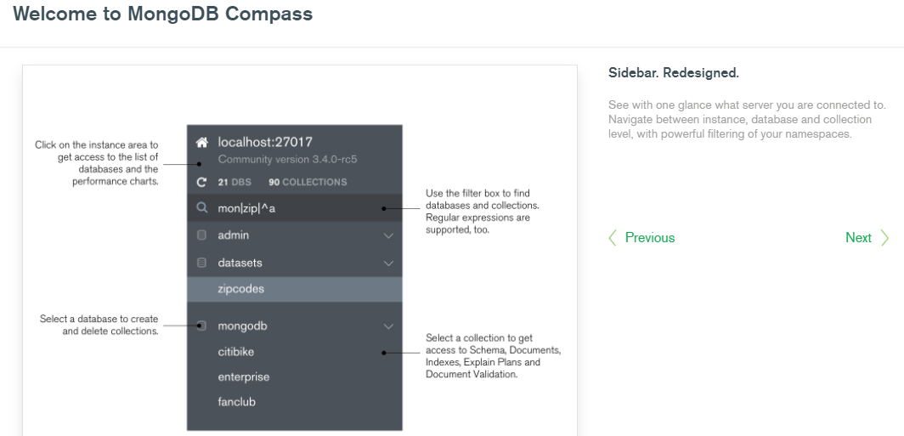
Some features of MongoDB compass

Slide 17
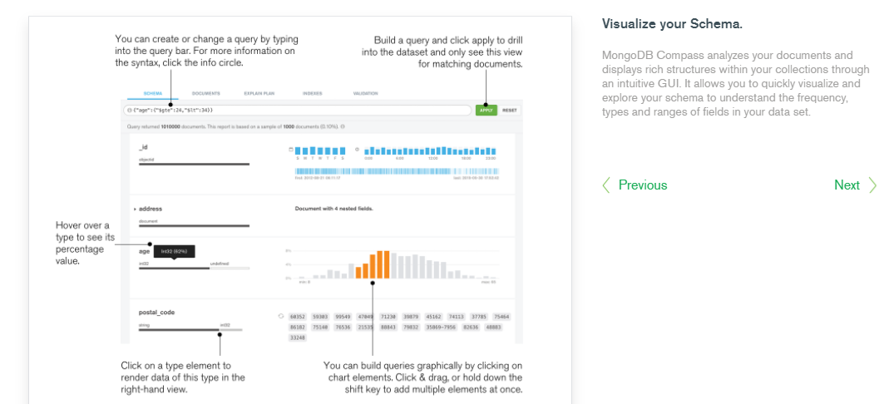
Some features of MongoDB compass

Slide 18
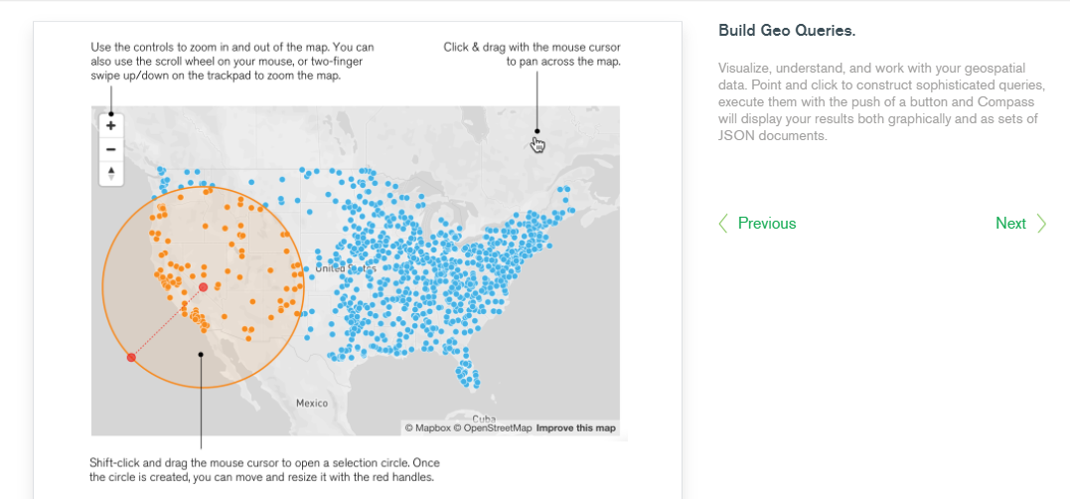
Some features of MongoDB compass

Slide 19
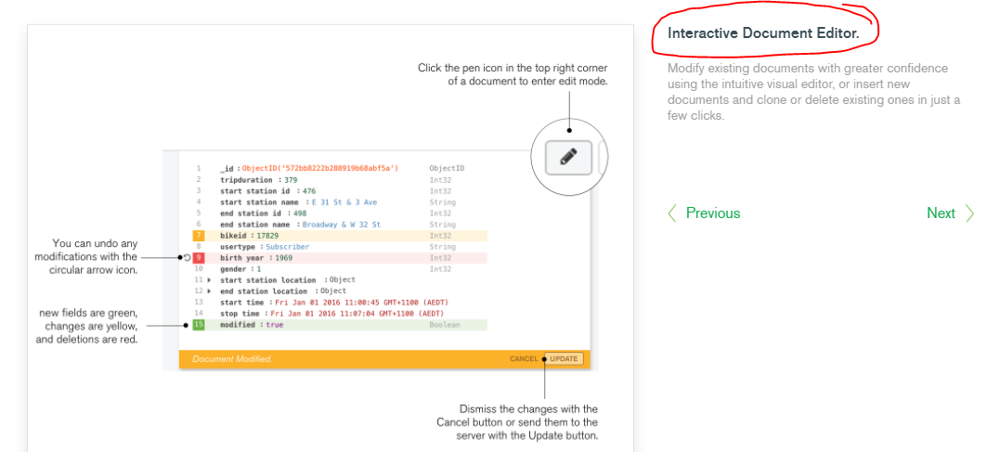
Some features of MongoDB compass

Slide 20
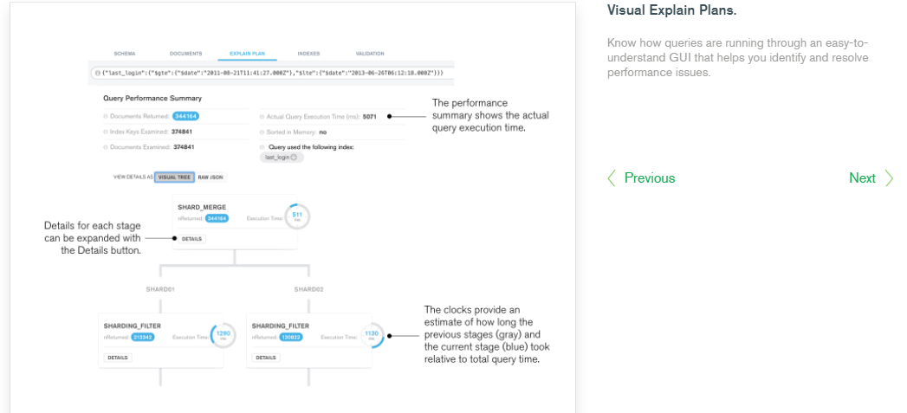
Some features of MongoDB compass

Slide 21
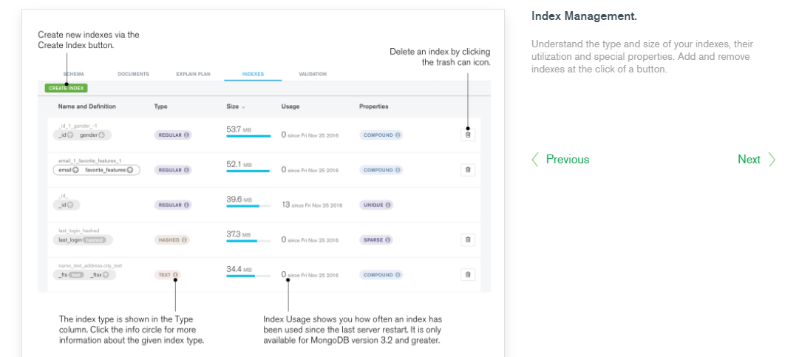
Some features of MongoDB compass

Slide 22
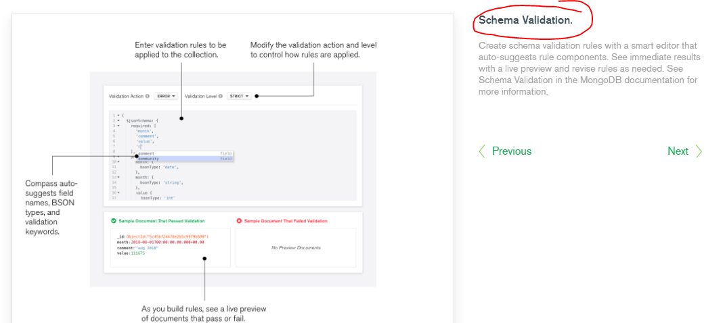
Some features of MongoDB compass

Slide 23
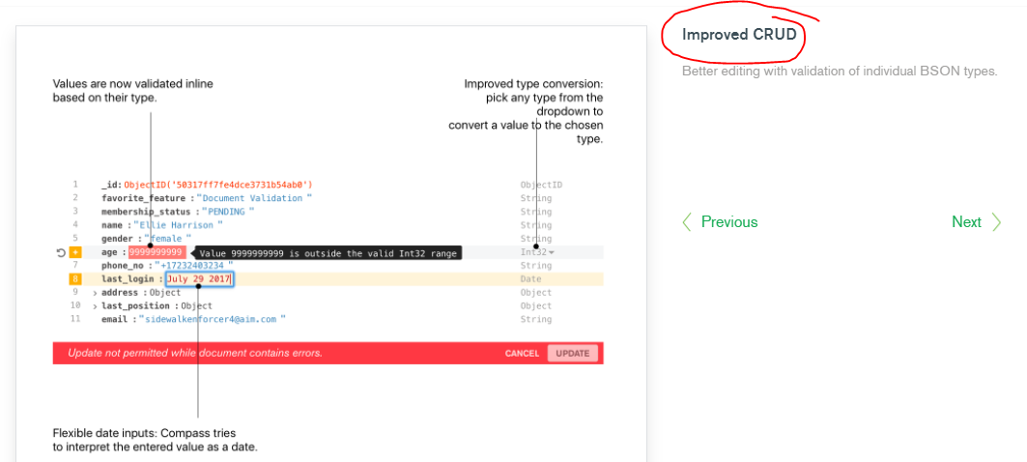
Some features of MongoDB compass

Slide 24
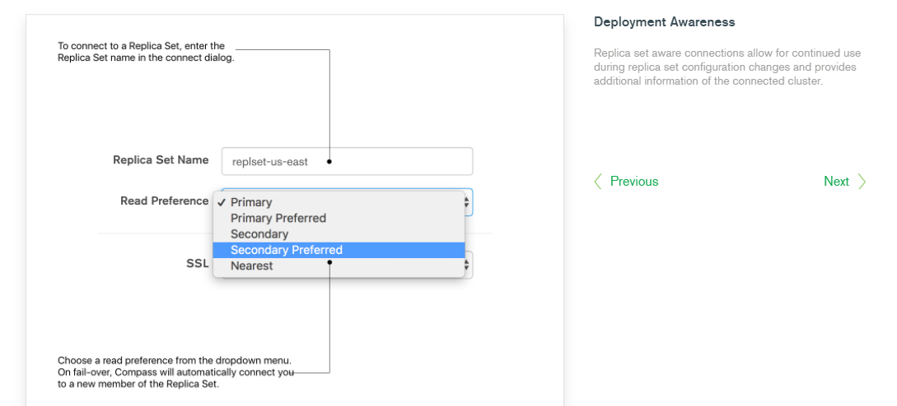
Some features of MongoDB compass

Slide 25
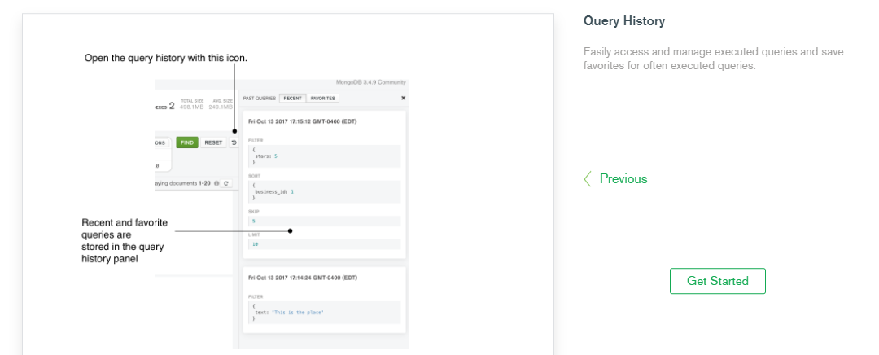
Some features of MongoDB compass

Slide 26
MongoDB default port number”
mongodb://localhost:27017

Slide 27
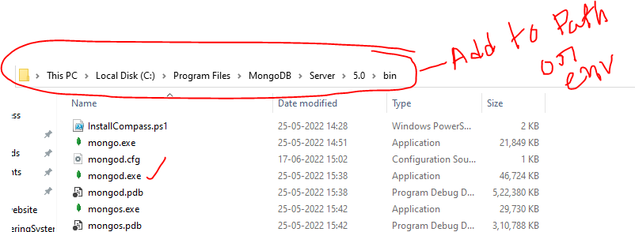
Add the following path to env veriable

Slide 28
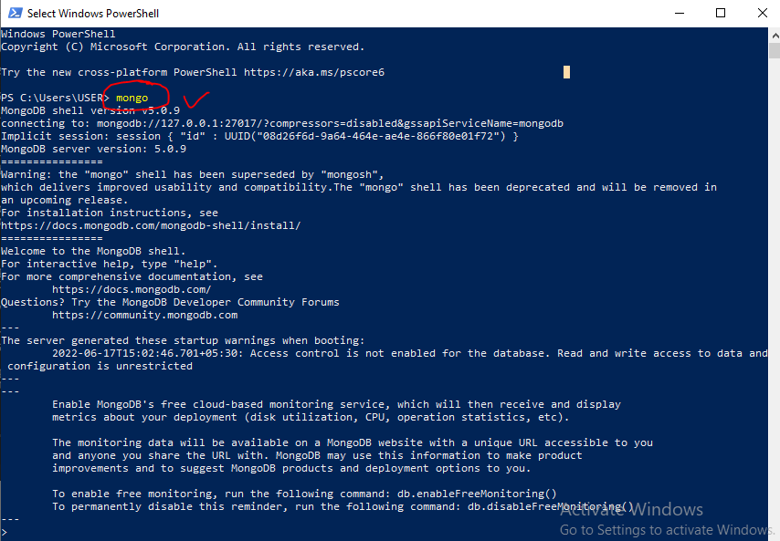
Start Mongodb using PS

Slide 29
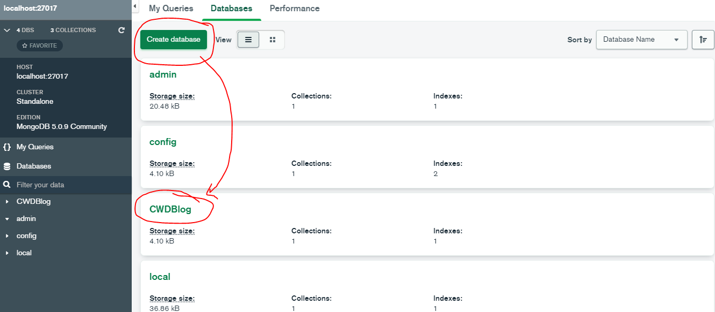
How to create db into mongodb compass

Slide 30
Advantages of MongoDB
MongoDB allows you to add any random key-value pair at any position.
But conventional DB link mysql,sql-server only follow the schema and attributes which we have mentioned at the time of table creation.

Slide 31
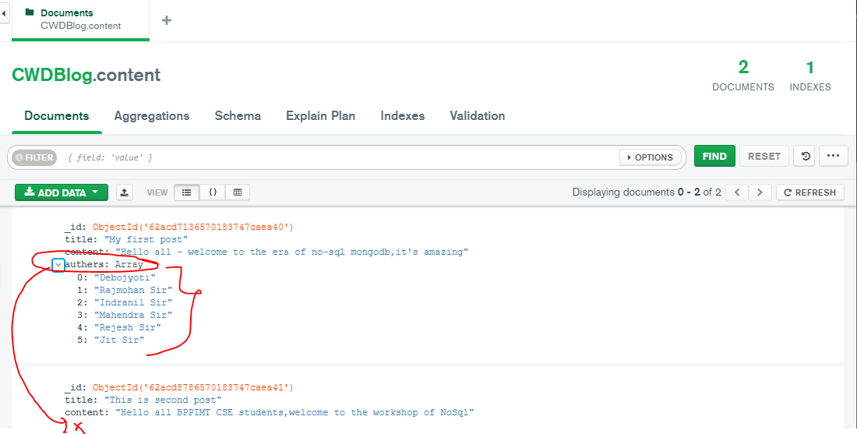
Advantage of MongoDB

Slide 32
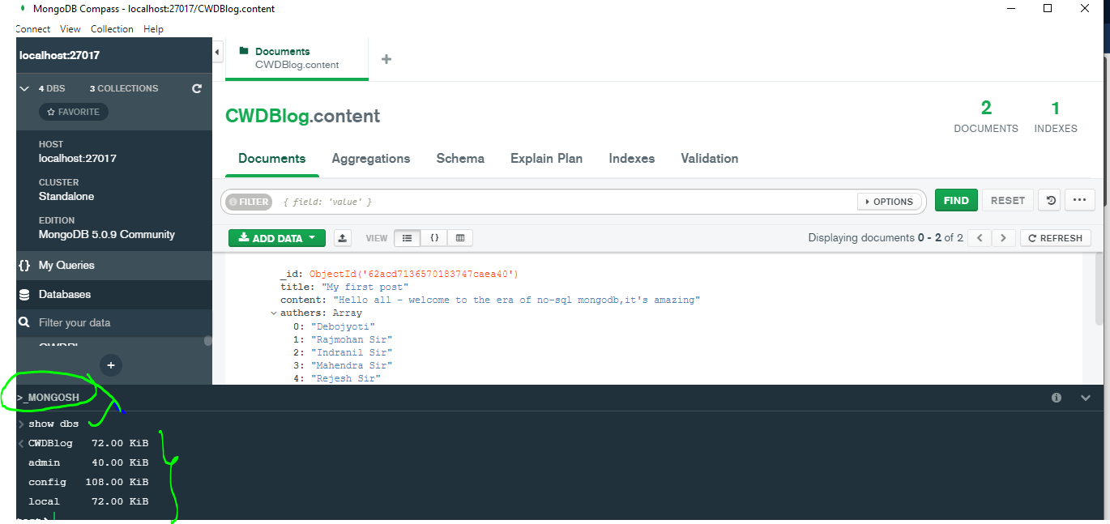
MongoDB Compass

Slide 33
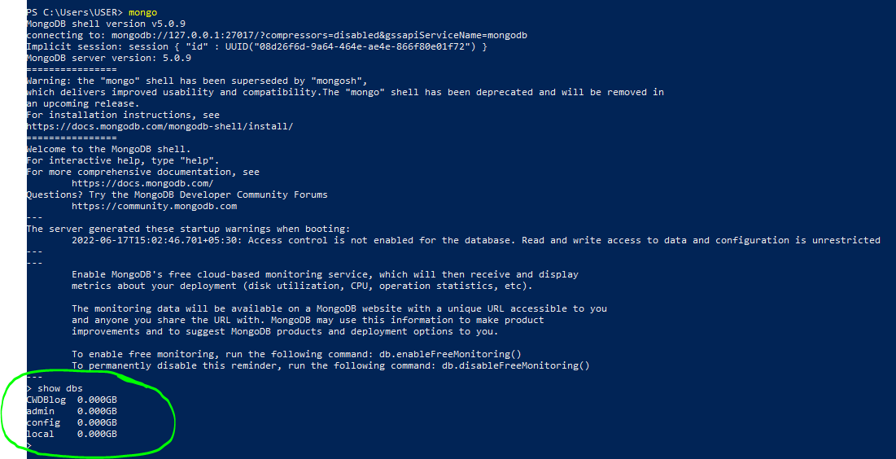
Some commands using PS

